Slide 1



Slide 2
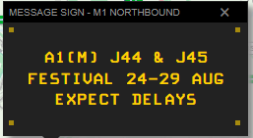
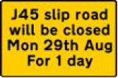

Pre-Event
Main difference for 2025 – A1M J43-J44 roadworks
Significant event for National Highways
Up to 90,000 attendees
Pre-event VMS and hard signs in place
Press release issued
Dedicated resources planned to support off-site traffic operation
Variable impact each year

Slide 3
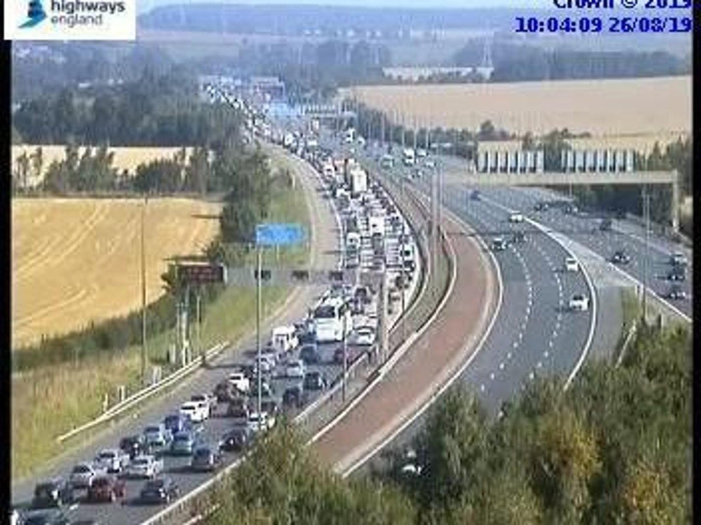
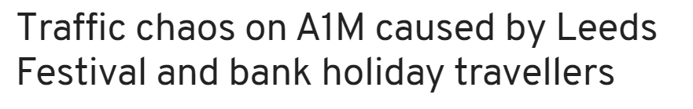
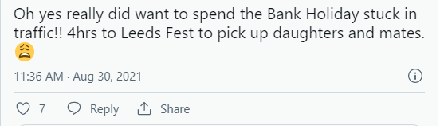
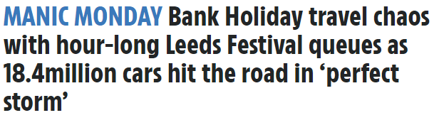
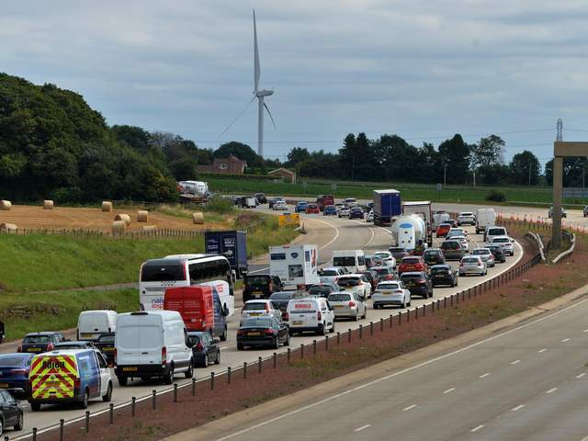
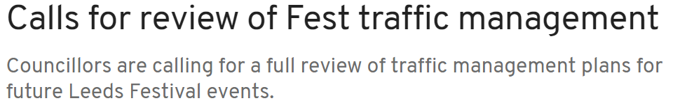

Slide 4
Arrivals
Peak inflow of vehicles to the Festival is likely to occur on Wednesday AM, Thursday daytime and daily from 10:00hrs to 13:00hrs Friday to Sunday inclusive.
Saturday is expected to be particularly busy this year with day tickets
All routes to the festival are from the A1(M)
‘Early bird’ ticket holder arrivals from Wednesday morning, but there has been less uptake this year
All parking is via Brown & White gates (Paradise Way) which will be open from 7am Wednesday
Teething issues can occur on Wednesday and will be addressed

Slide 5

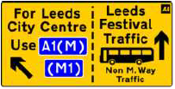
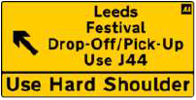
Drop-off & pick-up
All drop-off and pick-up traffic will be directed to J44 A1(M) and west on A64 and in via red gates
Due to the roadworks, hard shoulder running is already in place in Aberford Dip for J44 traffic
Free-flow lane from A1M J44J to A64 west
A64 will be closed eastbound from Red Bus Layby to J44
A64 westbound from J44 roundabout will be festival access only to red gates for drop off & pick-up
Directing traffic by hand as required at J44

Slide 6
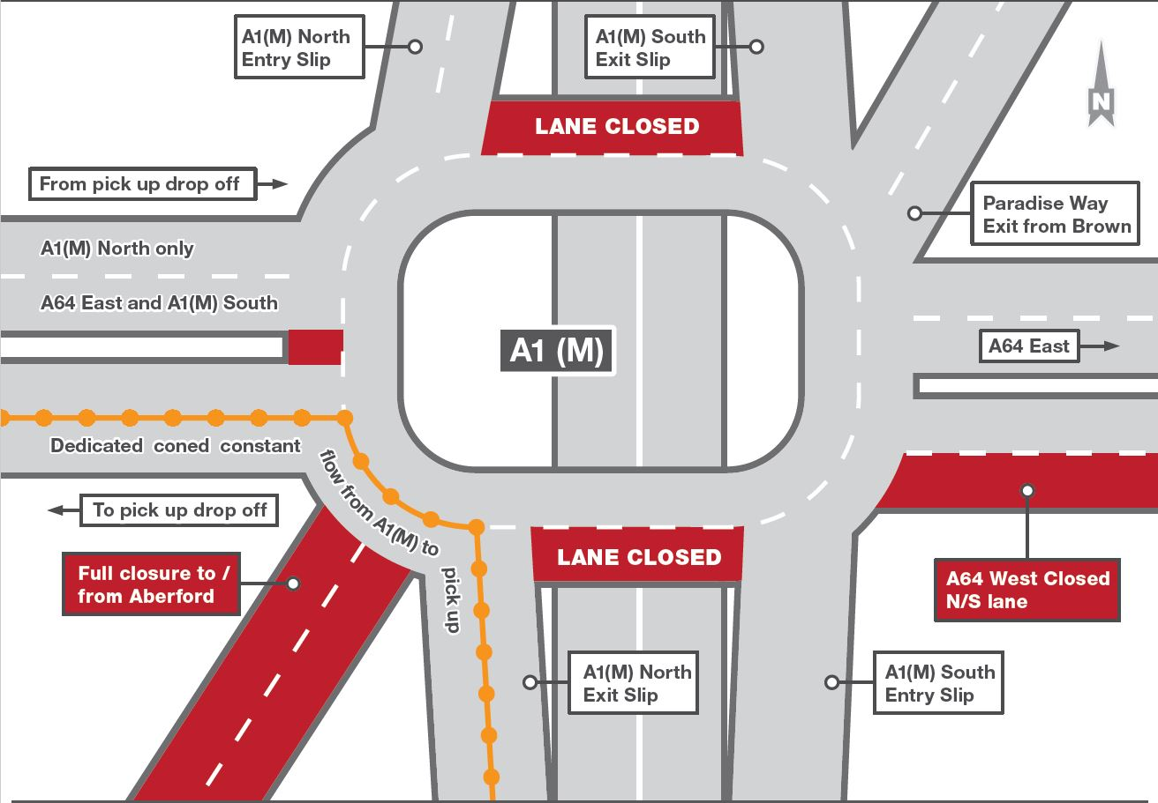
J44

Slide 7
Day & Weekend Parking
Southbound traffic will be directed to J44 A1(M) and requires all traffic to exit via J44 and join Paradise Way. Traffic will then enter the site, on a left turn, via White Gate (Bramham Park).
Northbound traffic will be directed to J45 A1(M). A dedicated, coned, lane will be installed at this slip road to ensure that Festival traffic can go straight onto Grange Moor roundabout without having to give way, reducing the risk of stationary traffic backing up to the main carriageway. Traffic will then go South on West Woods Road, left on to Thorner Road and then right onto Paradise Way and into site on a left turn into Brown Gate. (A further option, as a contingency to alleviate any congestion along Brown Route, is an additional right turn into White Gate).

Slide 8
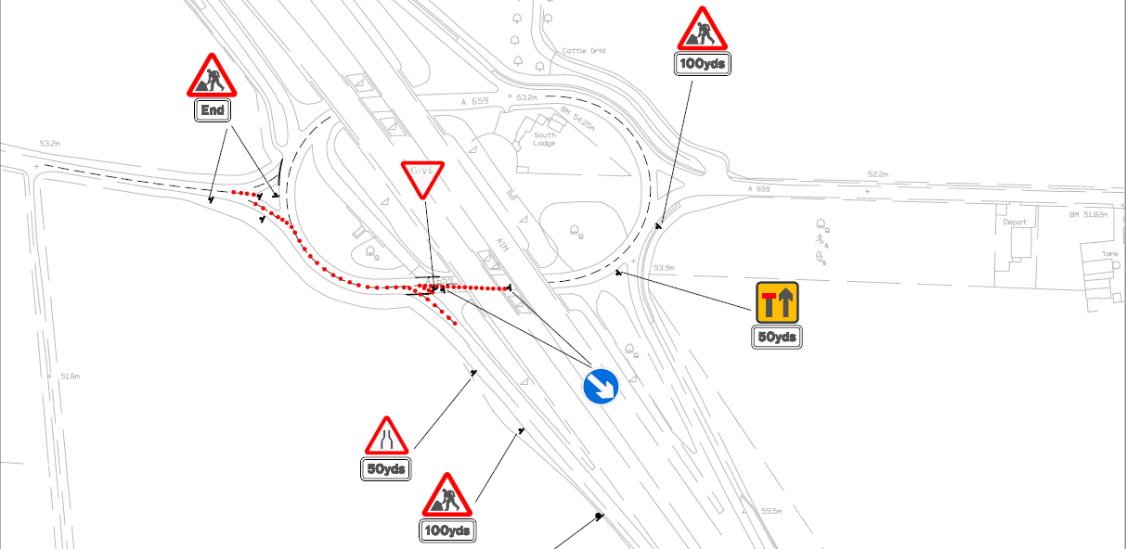
J45 free-flow coning

Slide 9
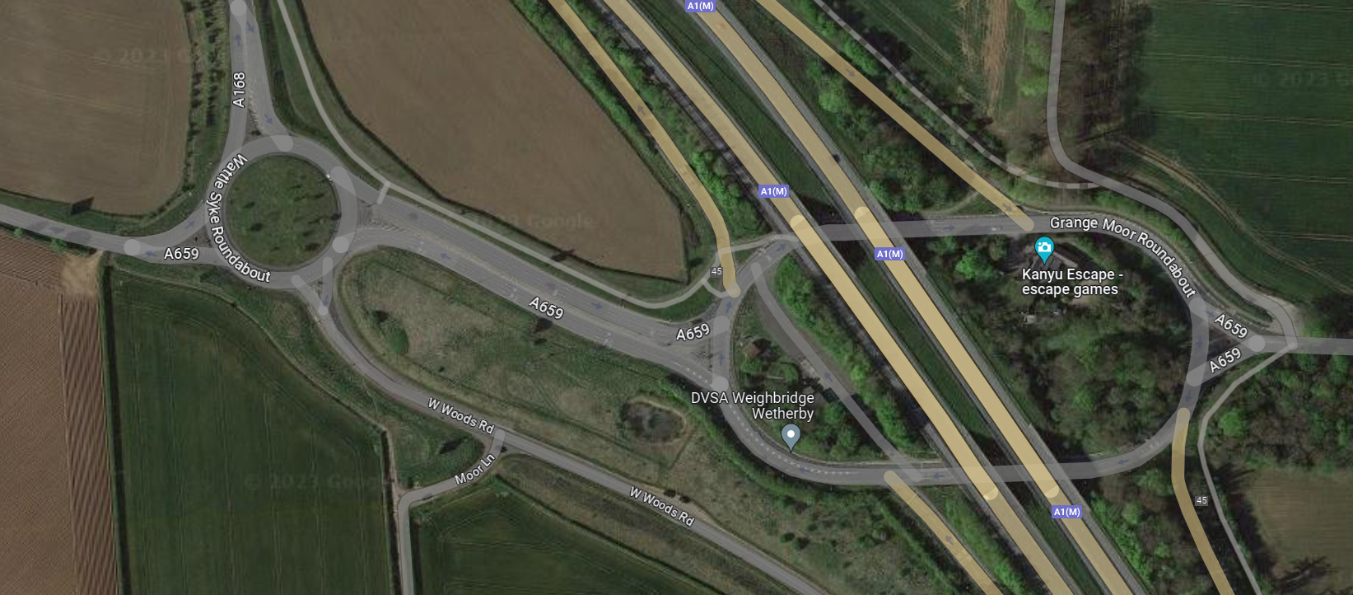
J45

Slide 10
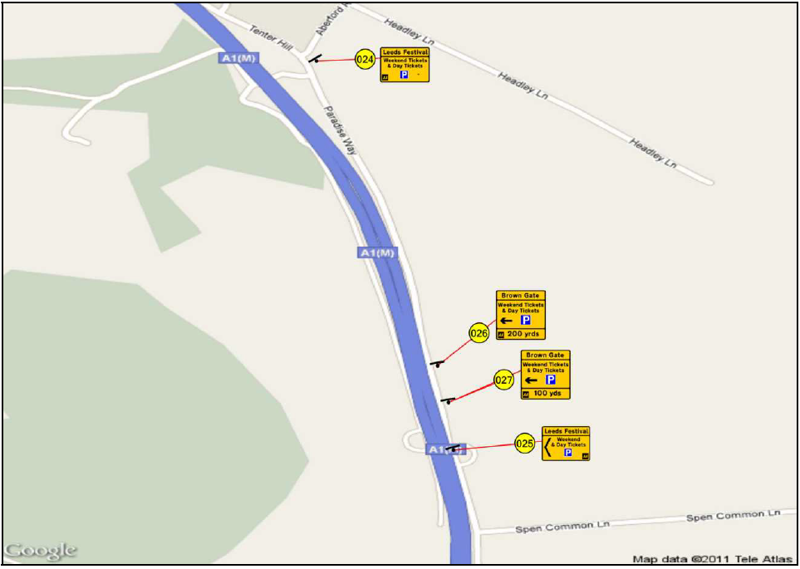
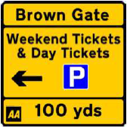
Day & Weekend Parking

Slide 11
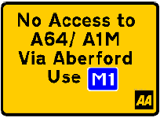

Aberford Closure
There will be no through-route from J47 M1 to J44 A1(M) via Aberford Village
This route is often used during period of congestion on the A1(M) including during the roadworks
There will be no through access throughout the duration of Leeds Festival. As per recent years, the junction of Main Street with the A64 just to the West of the Jct 44 roundabout will be closed from 04:00hrs on Wednesday 21st August to 15:00hrs on Monday 26th August.
HERAS fencing will be in place to deter drivers who move the cones

Slide 12
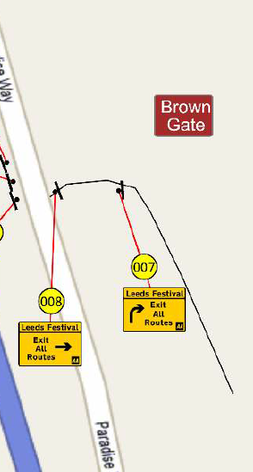
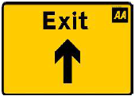
Egress
The peak outflow of vehicles from the Festival is likely to occur between 23:00hrs and 02:30hrs Saturday evening & Sunday evening and then from 08:00hrs to 14:00hrs on the Monday.
J45J A1M will be closed on Monday
Traffic will be directed right out of Brown gate, north to J45 (reverse of arrival)
West Woods Road will be closed southbound, with both lanes used to go north to J45

Slide 13
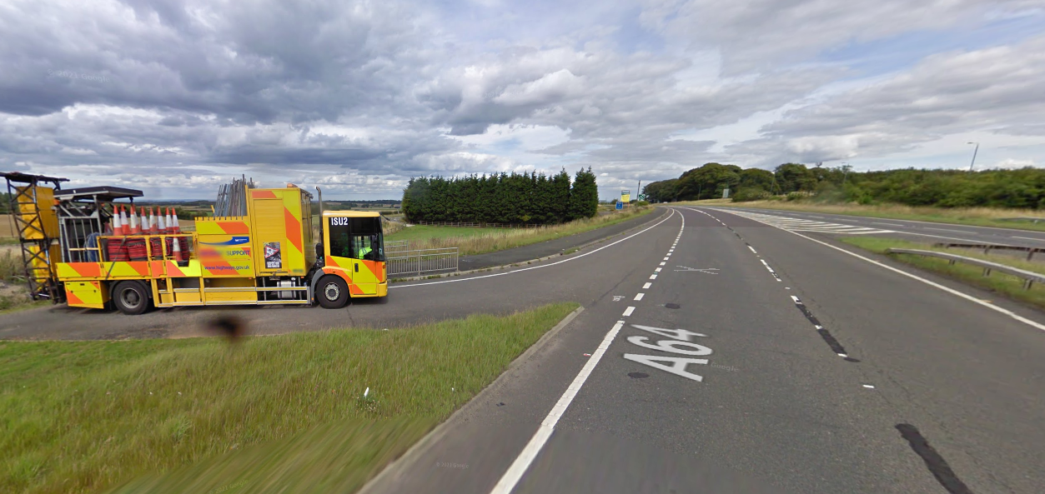
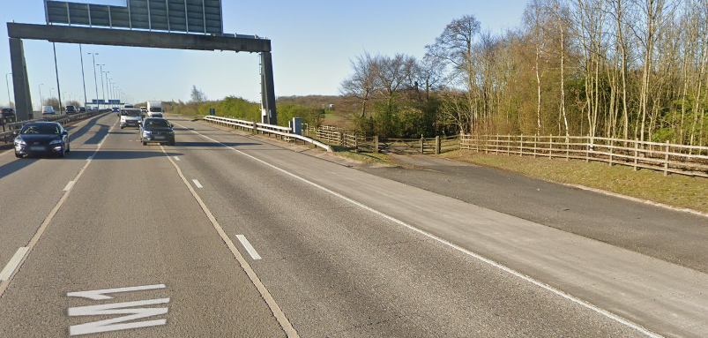
Patrolling and Strategic Park-Up
J44 roundabout is the key location throughout
Highly visible presence – Safety & customer focused
Get to know the area and the gates, ready to answer questions
Key focus: Aberford Dip, J44 roundabout & J45
Focused patrolling A1(M) J42-J46, M1 J46-J48 & A64 Bramham to Headley Bar
J44 roundabout is NH network (Area 12)
J45 – Authority to work on roundabout, Wattlesyke roundabout and A659 link
Welfare facilities Balfour Beatty Bramham Depot (off Paradise Way) Weds/Thurs/Fri
Wetherby & Skelton Lake Services
There are numerous restrictions and closures on local roads around the festival site. These include reduced speed limits, no waiting and no u-turns. WYP will be carrying out enforcement of these restrictions, including with camera vans.

Slide 14
Congestion & Incident Management
Dedicated Silver & Bronze commanders throughout
There will be a Leeds Festival log with dedicated resources assigned
Significant congestion and queuing is likely
Congestion reduced by hard shoulder running but increases workload
Focus is on keeping traffic moving safely
Free recovery available Saturday and Sunday evening – utilise it
ROC need to monitor MIDAS and send festival VMS messages to ‘top of queue’
No signal plan for 2025 due to the roadworks and mandatory 50 mph
Co-ordination with WYP & Festival Republic
Broken down vehicles in the roadworks will be dealt with by scheme free recovery
Pedestrians - Common issue on A64 and A1(M) near pick-up/drop-off. Consider vulnerabilities. May just need safety advice. Doesn’t need a log for every person seen.

Slide 15



